Slide 1

Monthly Family Fees
CAPPA Conference, October 2015
Sandy Patitucci, Child Development Consultant
Vanessa Saunders, Alternative Payment Manager

Slide 2
Agenda
Family Fee Background
  What is a Family Fee?
Family Fee Assessment
  Determining & Calculating Income
  Determining Family Size
Effective Dates for Family Fees
Determining Family Fee
Family Fee Notification, Collection & Receipts
Exception to Family Fee

Slide 3
Background
Budget Act of 2013 required SSPI to develop a flat monthly fee.
Fee schedule was developed in collaboration with stakeholder input.
Effective July 1, 2014

Slide 4
What is a Family Fee?
California Code of Regulations, Title 5 (5 CCR) Section 18078(g)
  A family’s share of cost based on sliding scale.
  Management Bulletin (MB) 14-03a provides contractors information on how to access a monthly family fee.
  The family fee schedule can be obtained from MB 14-03a.
  http://www.cde.ca.gov/sp/cd/ci/mb1403a.asp

Slide 5
Exceptions to Family Fees
EC, sections 8263 & 8273, 5 CCR, Section 18110
Children receiving Part-Day CSPP
  Families receiving CalWORKs cash aid while the aid is being paid to the parent
Child(ren) who are recipients of CPS, for up to 12 months, provided there is a written referral by a “legally qualified professional” or a Child Protective Services (CPS) worker;
  Child(ren) at risk of being neglected or abused, for up to 3 months, provided the there is a written referral from a legal, medical, or social services agency.

Slide 6
Family Fee Assessment
California Education Code (EC), sections 8239(a)(1), 8273, 8273.1, 8273.2, and 8447(b)(1)
The contractor must explain policies to the parent regarding:
  fee assessment
  fee collection
  consequences for delinquent payment of fee

Slide 7

Family Fee Assessment
California Education Code (EC), sections 8239(a)(1), 8273, 8273.1, 8273.2, and 8447(b)(1)
Families are assessed a flat monthly fee based on:
  total countable income
  family size
  family’s certified need
Fees are assessed at initial enrollment and reassessed at the time of recertification or when the family data file is updated.

Slide 8
Determining Income
5 CCR, Sections 18084 and 18096
Contractors are required to obtain, calculate, and verify the “total countable income” of the family.
Contractors are required to utilize and retain in the family data file, an income calculation worksheet.
An example of an income calculation form can be obtained through the CDD website at:
  http://www.cde.ca.gov/sp/cd/ci/documents/incomecalcworksheet.doc

Slide 9
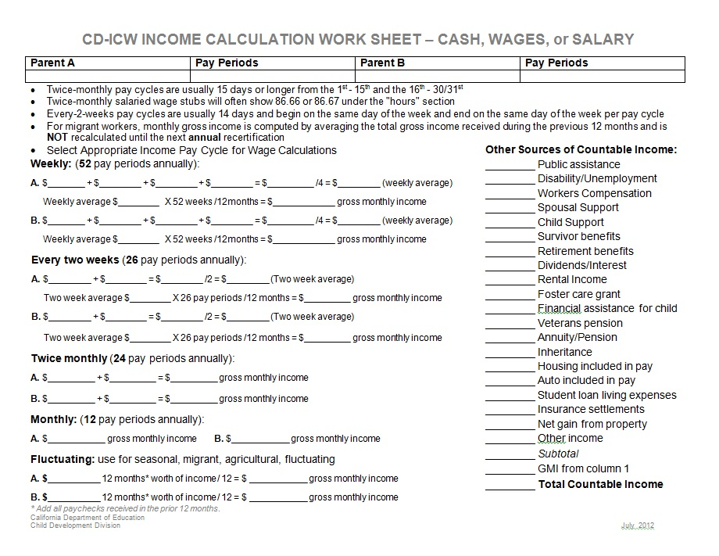
Determining Income

Slide 10
Determining Family Size
5 CCR, Section 18100
The parent shall provide the following information.
  names of the parents
  names, gender and birthdates of the children identified in the family
The parent must provide supporting documentation regarding the number of children and parents in the family.
The information is documented on a confidential application and is used to determine family size.

Slide 11
Determining Certified Need
EC, Section 8263
Is based on certified need as documented and approved on the application for services.

Slide 12
Determining Family Fee
5 CCR, Section 18109
Predictable Schedule
Use the total monthly number of certified hours of care as documented in the application for services (CD 9600)
Under 130 hours of certified hours of care; a part-time monthly fee is assessed
130 or more hours of certified hours of care; a full-time monthly fee is assessed

Slide 13
Determining Family Fee
5 CCR, Section 18109
Variable or Unpredictable Schedule
(refer to 5 CCR, Section 18086(a)(2)(D))
Use the average hours of the parent’s verified work schedule for the four month’s immediately preceding the certification
When updating the need for services reassess the fee by averaging the prior four months of attendance

Slide 14
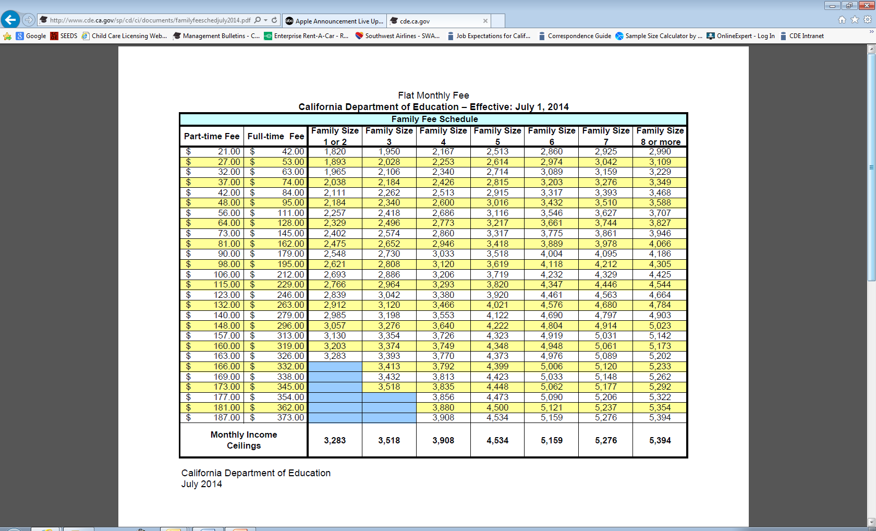
Family Fee Schedule

Slide 15
Notice of Action (NOA)
Newly enrolled families: On NOA, Application for Services (5 CCR, Section 18094) the contractors must include monthly fee, effective date, and due date.
Recertification/Update: On the NOA, Recipient of Services (5 CCR, Section 18095) the contractor must include (if applicable) the new monthly fee, effective date, and due date.
Notes:
A NOA is issued to the family showing the new fee and contains an effective date either 14 or 19 calendar days after service of the NOA

Slide 16
Fee Assessment and Effective Dates
EC 8273
The due date for fees assessed at initial enrollment will be the date of enrollment, and first of the month there after.
When the initial enrollment is not on the first day of the month, assessment of the fee can be based on the hours of care needed for the partial month or the cost of care, whichever is less.
Fees will be reassessed during the recertification or update process
When a fee has been reassessed, the due date for the fee will be on the first of the month following the effective date of the NOA.

Slide 17
Credit for Fees Paid
5 CCR, Section 18112
Family fees paid for additional child care services not met by the contractor can be credited to the family’s subsequent fee billing period, provided that the parent supplies the contractor copies of receipts or cancelled checks to verify the amount of the fee paid to the provided to the other provider.

Slide 18
Delinquent Fees
5 CCR, sections 18115 and 18116
  The family fee is considered delinquent after seven (7) calendar days of the due date
  Services shall be terminated through a Notice of Action (NOA)
  A reasonable repayment plan can be accepted and the parent must comply with the repayment plan for continued services

Slide 19
Policies
5 CCR, Section 18114
Contractors shall develop and adopt policies for family fees and the collection of those fees
Fees are to be collected in advance of providing services
Policies shall address fee assessment, collection, and the consequences of delinquent payments
Written policies shall be provided to families during the initial enrollment

Slide 20
Family Fee Receipts
5 CCR, Section 18113
  Contractors must provide an original copy of a pre-numbered receipt to each family that pays a fee
  Receipts must indicate
    amount paid
    date of payment
    fee charged
    period of services being paid

Slide 21
Family Fee Collection
After determining the family fee, the contractor shall maintain a record of:
  each family’s fee assessment
  effective dates
  any fee changes
  dates and amounts of fees collected
  any amounts that are delinquent
Contractors shall notify families of the monthly fee in advance of services

Slide 22
Resources
Family Fee Schedule http://www.cde.ca.gov/sp/cd/ci/familyfeeschedjuly2014.asp
Online Family Fee Calculator http://www2.cde.ca.gov/familyfee/famfeecalc2014.aspx
MB 14-03a http://www.cde.ca.gov/sp/cd/ci/mb1403a.asp

Slide 23
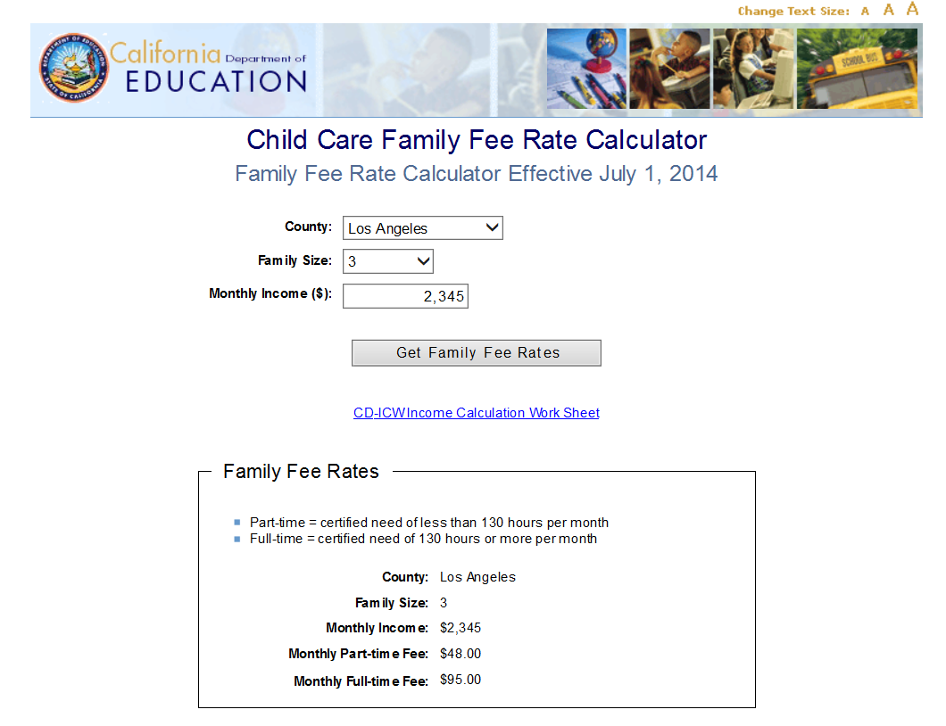
Online Family Fee Calculator http://www2.cde.ca.gov/familyfee/famfeecalc2014.aspx

Slide 24
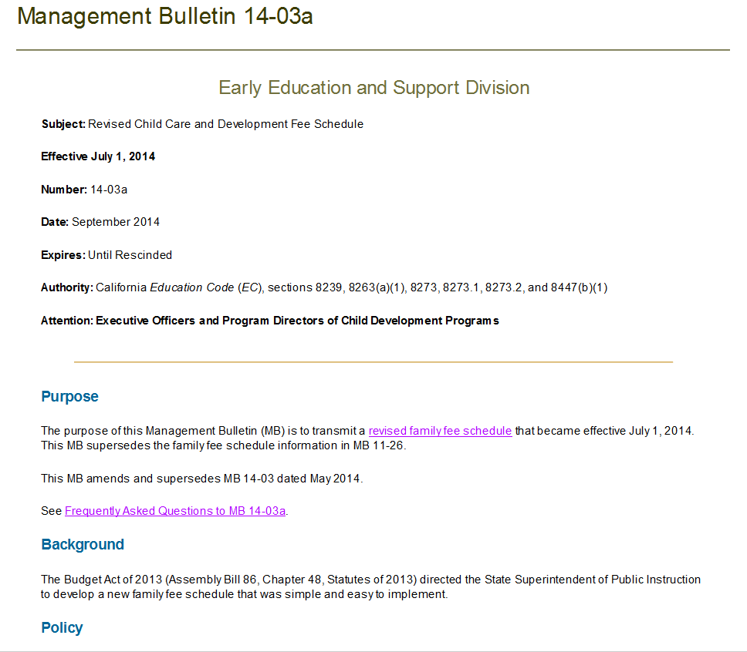
MB 14-03a

Slide 25

Questions?

